Slide 1
Marketing Concepts
What Is Marketing?
1. The Production Concept
2. The Product Concept
3. The Selling Concept
4. The Marketing Concept
5. The Societal Marketing

Slide 2
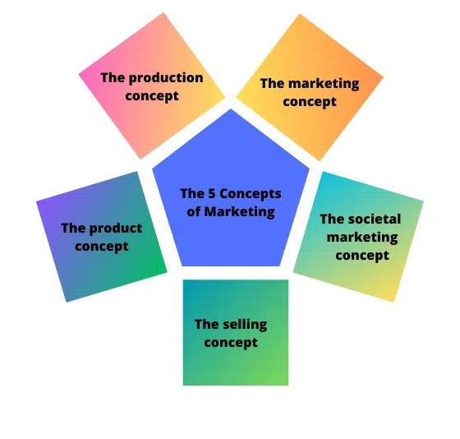

Slide 3
The Production Concept
The production concept suggests that people prefer products and services that are easily available and affordable, which is essentially the idea of mass production.
Focusing your marketing efforts on this concept means you’re looking to achieve a highly efficient production process, keep costs low, and aim to scale production.
Think Walmart, McDonald’s (or any of the big, fast food franchises), Forever 21, Starbucks, and countless other big brands you’ll find across the U.S. in every mall, town, and city. They all use this approach.
Brands that focus on mass production keep costs low and sell to a large customer base. Each item sold attracts a low-profit margin, but selling at a very high volume ensures that profit remains high.

Slide 4
2. The Product Concept
The product concept emphasizes that buyers prioritize a product’s quality, features, and benefits. Product-focused buyers seek innovation and uniqueness rather than solely seeking the lowest price.
A prime example that exemplifies this type of marketing is Apple. Apple products are renowned for their exceptional user experience.
They are designed to be user-friendly, intuitive, and easy to set up and update. Every aspect, from their sleek packaging to their minimalist design and intuitive controls, exudes elegance.

Slide 5
Apple sets a premium price for their products, but their dedicated fan base is willing to pay for the superior quality and user experience they offer.
When customers purchase an Apple product, they have a clear understanding of what they’re getting. Apple also prioritizes accessibility, which sets their products apart in the market.

Slide 6
3. The Selling Concept
The selling concept is founded on the belief that customers will not purchase an adequate quantity of a product or service unless they are actively persuaded to do so.
This concept assumes that customers tend to be resistant and need to be convinced to make a purchase. Marketing strategies rooted in the selling concept involve pervasive and continuous advertising efforts.
Companies that embrace this concept often employ various techniques to sway hesitant buyers into making a purchase. This approach is commonly utilized by companies that have excess inventory and need to sell it in order to create space for new products.

Slide 7
Examples of employing the selling concept include:
Brands that aggressively promote Black Friday (and Cyber Monday), such as Amazon, although many big brands also use very similar tactics.
Brands that heavily rely on email marketing — think of those that flood your inbox with daily emails that advertise discounts, sales, and special offers. These brands constantly strive to capture your attention with their latest deals.

Slide 8
4. The Marketing Concept
You read it right, one of the 5 marketing concepts is “the marketing concept”. While the selling concept is all about what the company wants or needs, the marketing concept focuses on the customer.
If you’ve hung out in marketing groups or social media pages online, you’ll have heard discussions about concentrating on solving a customer’s problem to build a sustainable business.
Brands that utilize the marketing concept spend time getting to know their customer’s likes and dislikes. They understand what problems keep their customers awake at night and develop products and services

Slide 9
This is the approach you’ll see small businesses take. While they can’t compete on scale or price with more prominent brands, they can, through a deep understanding of their customer, fill the gaps in the market and meet a niche demand.
You’ll often see this approach with freelancers building small, agile businesses online. Spend time on LinkedIn and engage with content from copywriters, designers, coaches, and consultants, and you’ll see how they interact with their audience — often asking (and answering) questions in their chosen niche.

Slide 10
5. The Societal Marketing
The societal marketing concept takes the marketing concept further and is increasingly becoming the concept of choice when devising a marketing strategy.
This concept emphasizes focusing on meeting customers’ needs to solve their problems while ensuring no harm comes to them.
You should also provide this solution as ethically as you can.
Examples of brands and products that focus on this marketing concept include:
Herbivore and other beauty brands use organic ingredients and claim that their products are ethically produced and do not harm the environment
Reformation – a clothing brand that focuses on ethically made clothing produced without harm to nature.

Slide 11
Which Concept of Marketing Is The Best?
Well, it depends.
The concept of marketing you choose depends on your business, your product or service, and your relationship with your customers.
There are also several other factors to consider. We must approach some concepts, such as the production concept, cautiously.
Mass production has several issues. It’s usually environmentally destructive and may involve exploiting workers making the product. That is not to say this is the case for all mass-produced items, but it is a reality in numerous instances.

Slide 12
If you’re looking to build a long-term business, you should consider your customers’ needs.
In this day and age of mass consumption, you need to make sure your business practices are ethical. Also, your product is environmentally friendly, and you are addressing the genuine need of your customer.
By incorporating the marketing and societal marketing concepts into your marketing strategy, you establish a solid foundation to foster the long-term growth of your business.
Nail These Marketing Concepts to Engage Customer Attention
To build a strong marketing campaign for your business, it’s essential to understand the five marketing concepts.

Slide 13
Trying to close a sale with a reluctant buyer will never end well, and you may see a higher rate of returns and refunds, which could negatively impact your business reputation.
On the other hand, if you’re trying to sell a product with no demand or leads who aren’t ready to buy, you don’t have a viable business.
To avoid these pitfalls, your marketing efforts should focus on targeting the right people, understanding the buyer journey, and offering customers products and services that solve their problems.
Being trustworthy isn’t just the right thing to do, it also makes the most sense for your business.

